Slide 1
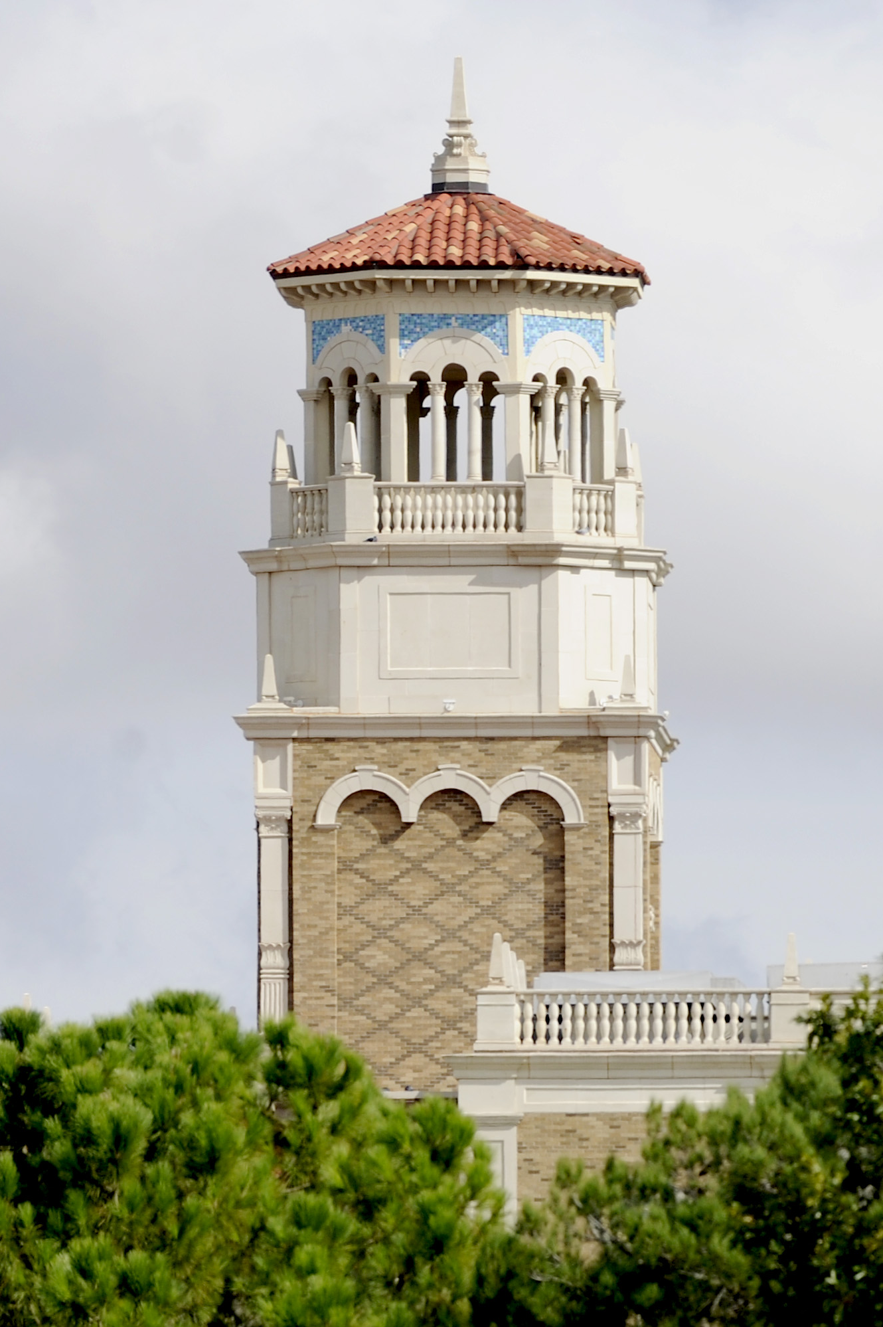
OnlineLPK12
Title: Advancements and Enhancements in the OnlineLPK12 Project
Date: Dec 6th (Wednesday)
Time: 9:30 to 10:30am CST
Location: department of computer science room 104 (inside dept office)
tation Headline REPRESENTATIVE SUBHEAD TO SUPPORT SUBJECT
Presenter’s Name Position Title February 12, 2005
Presenter's Name:
Navya Anumolu
Sanjana Mutyala
Shreyas Prabhakar
Siva Naga Brahmam Vuyyuru
Susmitha Reddy, Bodam

Slide 2
Introduction
This project is a continuation of Early work done By Professor Yuanlin, Zhang and other grad students.
Main objective of the project is to design and develop an effective Logic programming-based system with deep integration of computation thinking and STEM education for K-12.
LPK12 achieves deep integration by building models for problems through Answer set programming – a modern LP paradigm.

Slide 3
Objectives and Goals
Understand the existing system.
Setup the existing system in local computers.
Test the existing system and validate the functionalities.
Fix any issues or bugs found.
Populate the system with new lessons, assessments and quizzes.
Enhance the existing system design.
Update the database to store and validate the quiz answers.

Slide 4
Understand & setup the existing system
Team has wade through the documents related to existing system
Understood the design and architecture of the system
Clarified the doubts and gaps on the system
Installed required software's for the system to run successfully in local systems.
Updated the installation document with challenges faced and the solutions to solve the issues faced.

Slide 5
Test the existing system and validate the functionalities
Tested and validated the content of existing lessons.
Identified the bugs in Sparc editor and fixed them.
Identified the existing lessons content was not properly aligned and enhanced the content.
Found that there were no validations applied to the assessment or quizzes and we have implemented the validations.
Observed that the GIF’s used in the existing system are not working as expected and fixed them.

Slide 6
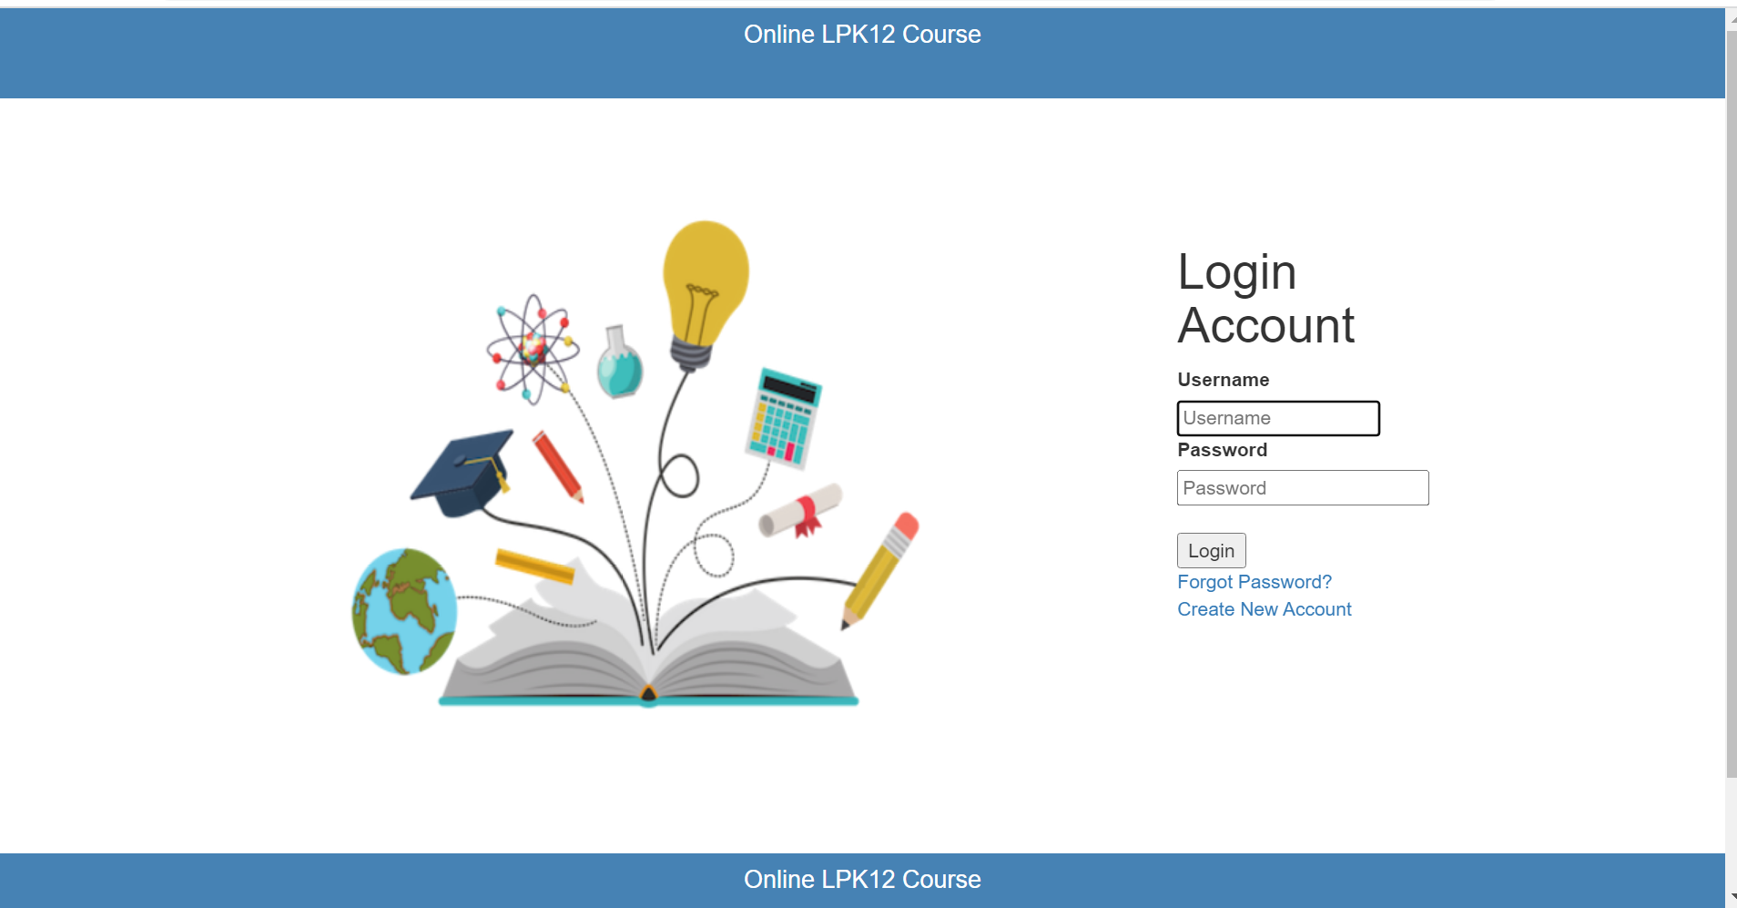
Enhanced the existing system design (Login Page)
Before

Slide 7
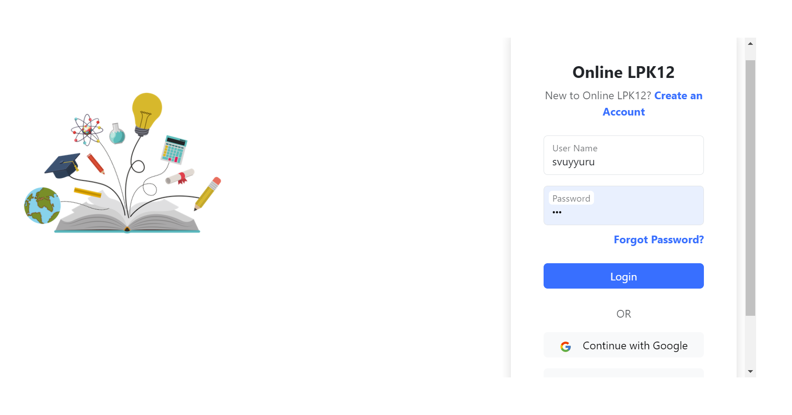
Enhanced the existing system design (Login Page)
After

Slide 8
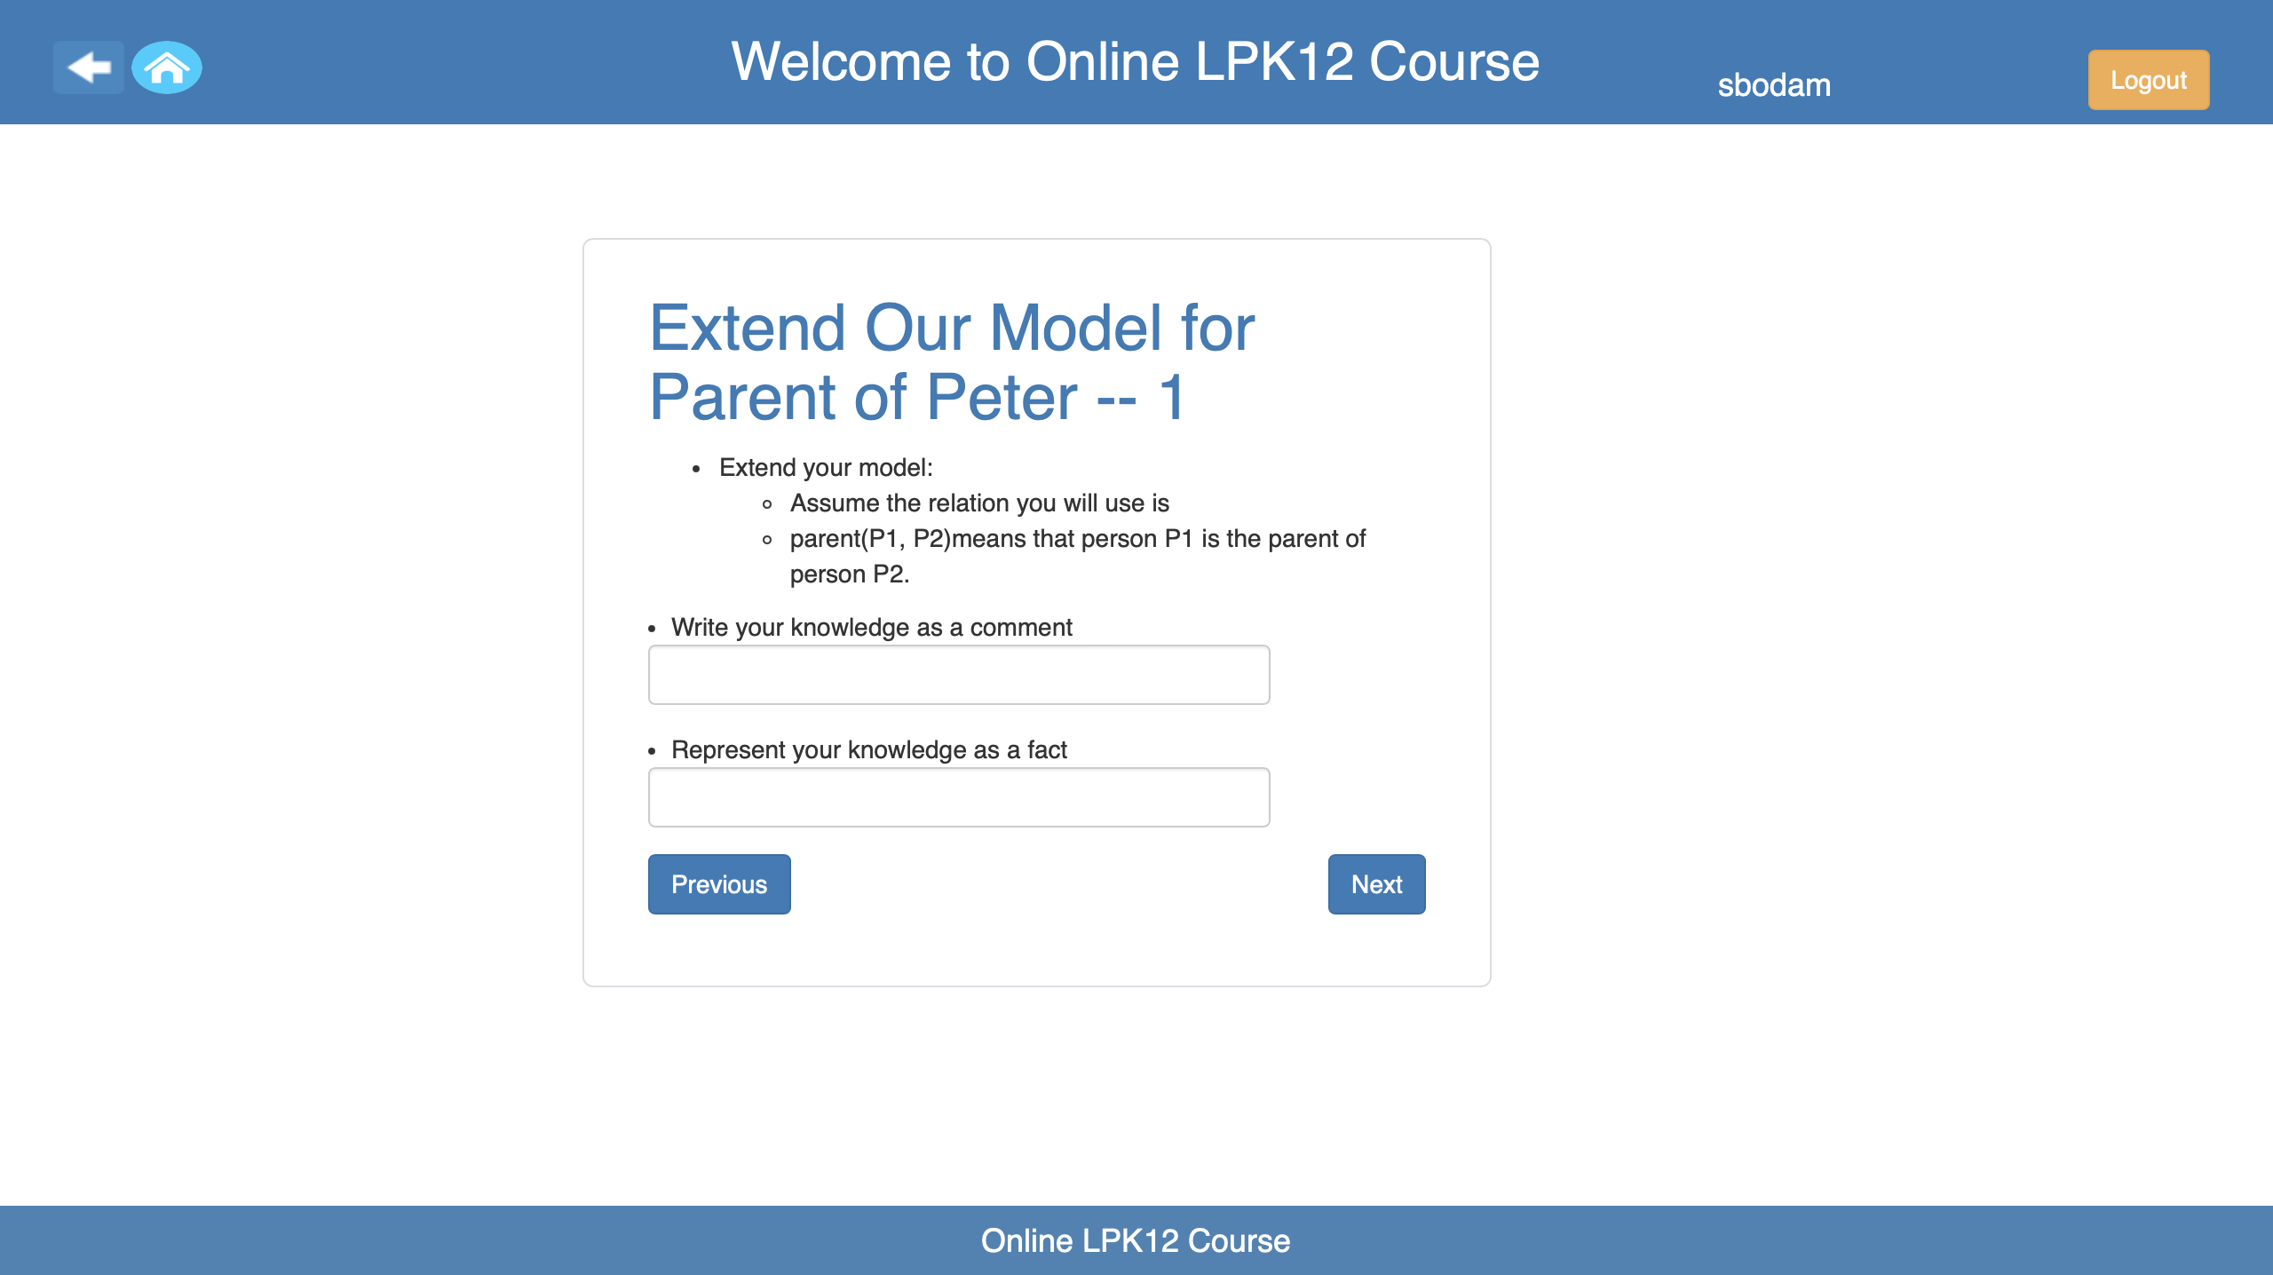
Enhanced the UI of existing lessons
Before

Slide 9
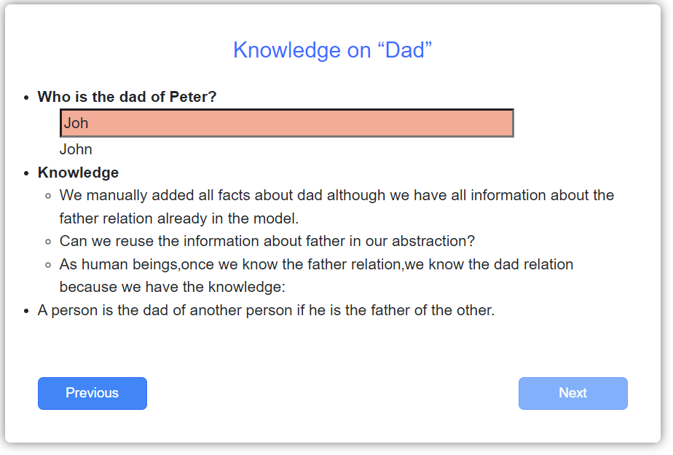
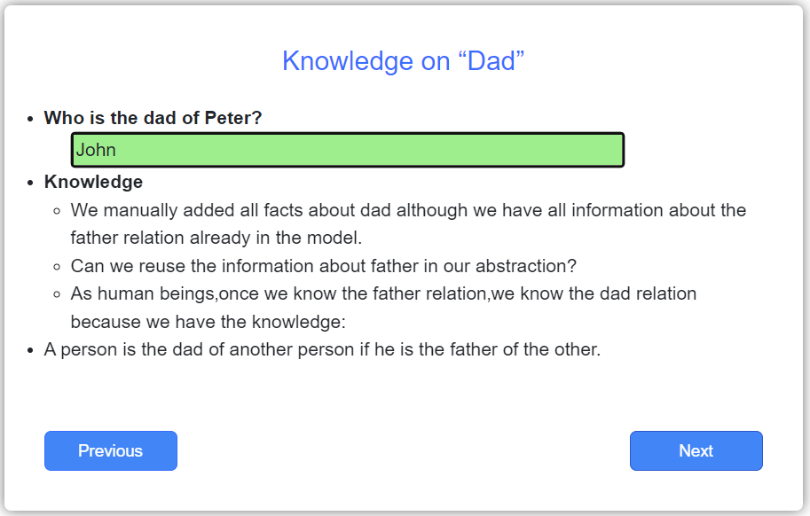
Enhanced the UI of existing lessons
After

Slide 10
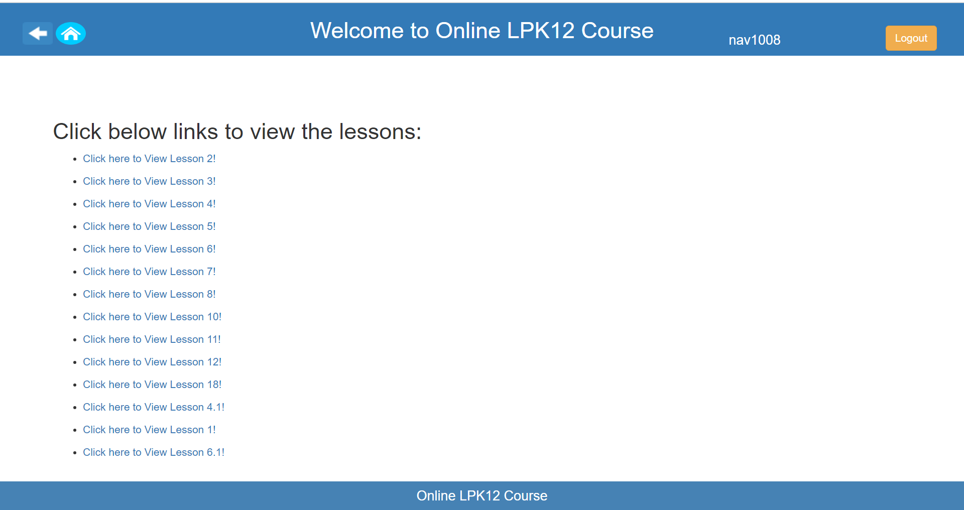
Design of new home page
Before

Slide 11
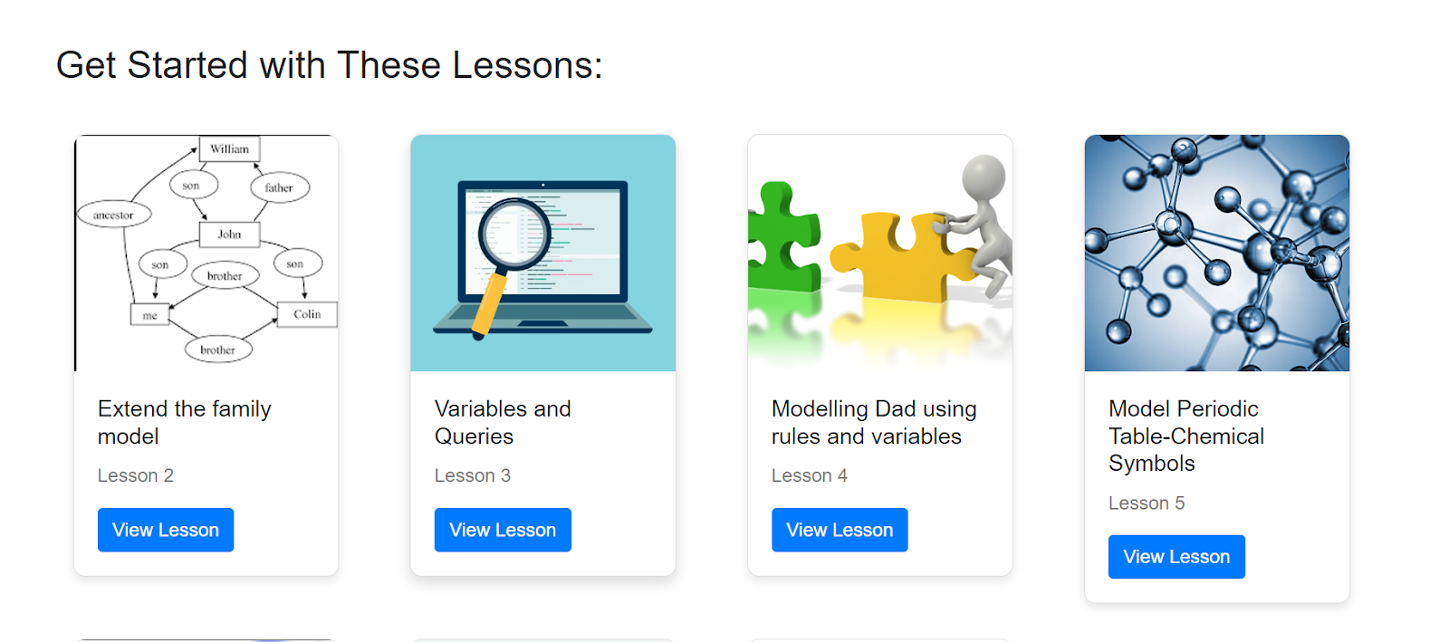
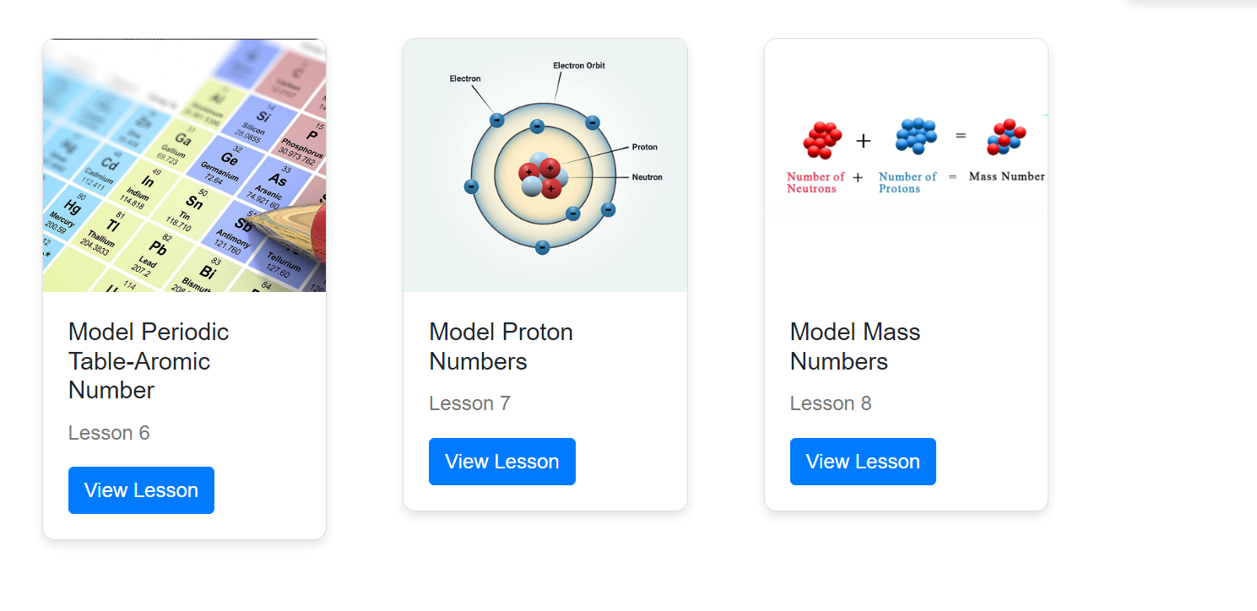
Design of new home page
After

Slide 12
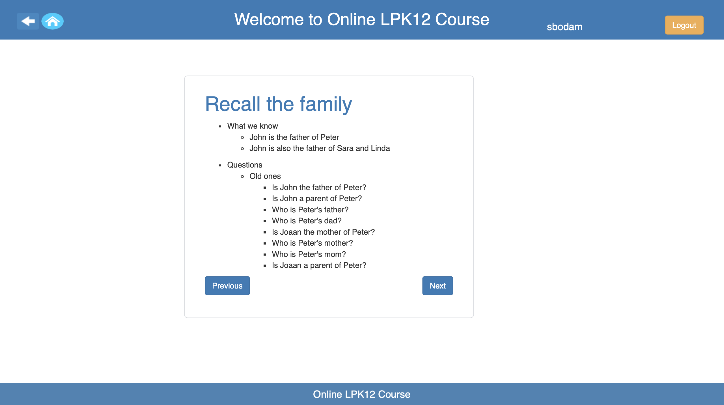
Enhanced the UI of existing lessons
Before

Slide 13
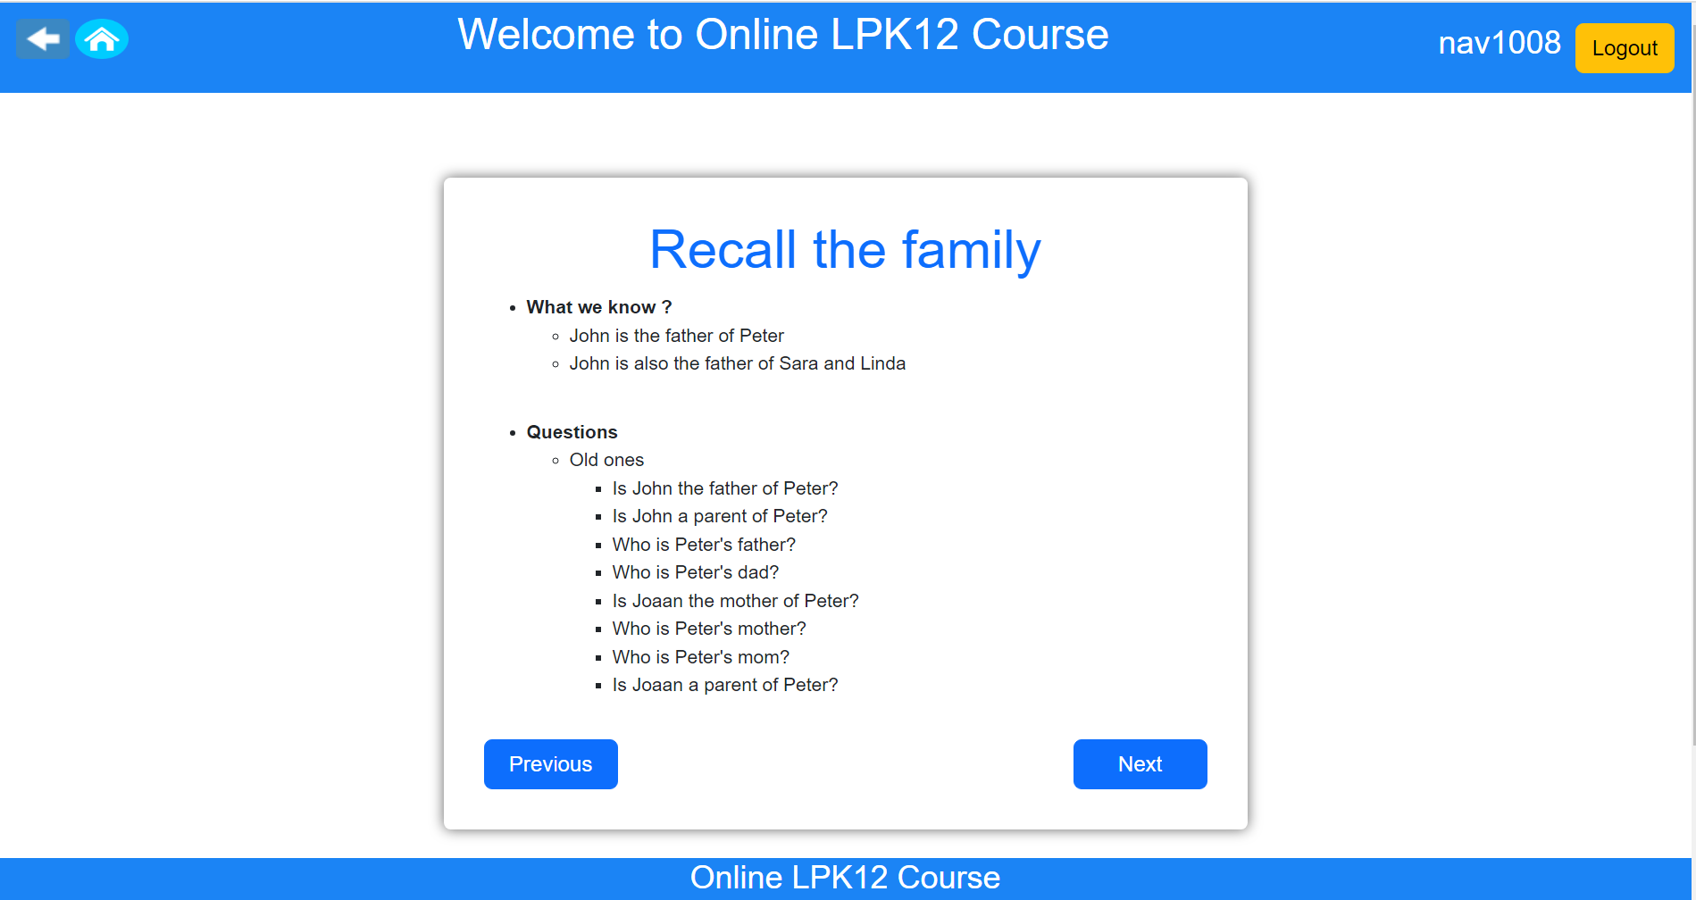
Enhanced the UI of existing lessons
After

Slide 14
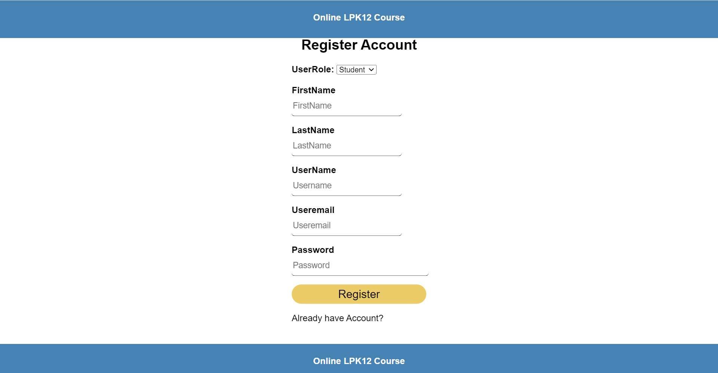
Modified the design of Register page
BEFORE

Slide 15
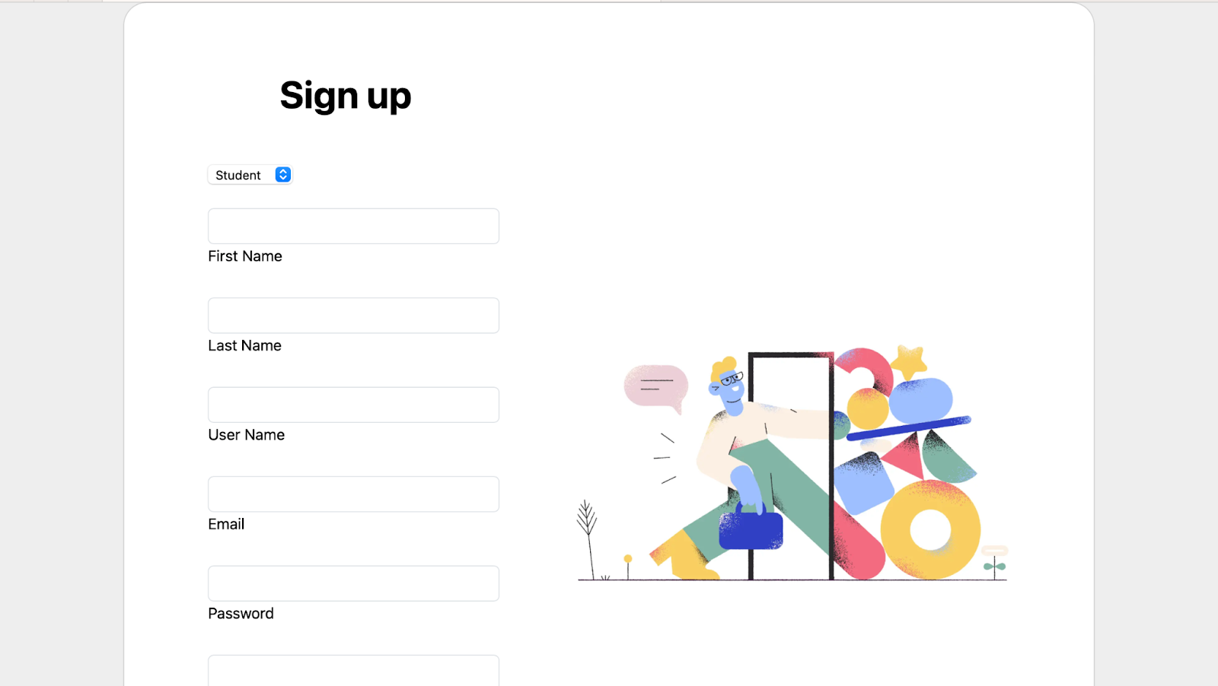
Modified the design of Register page
AFTER

Slide 16
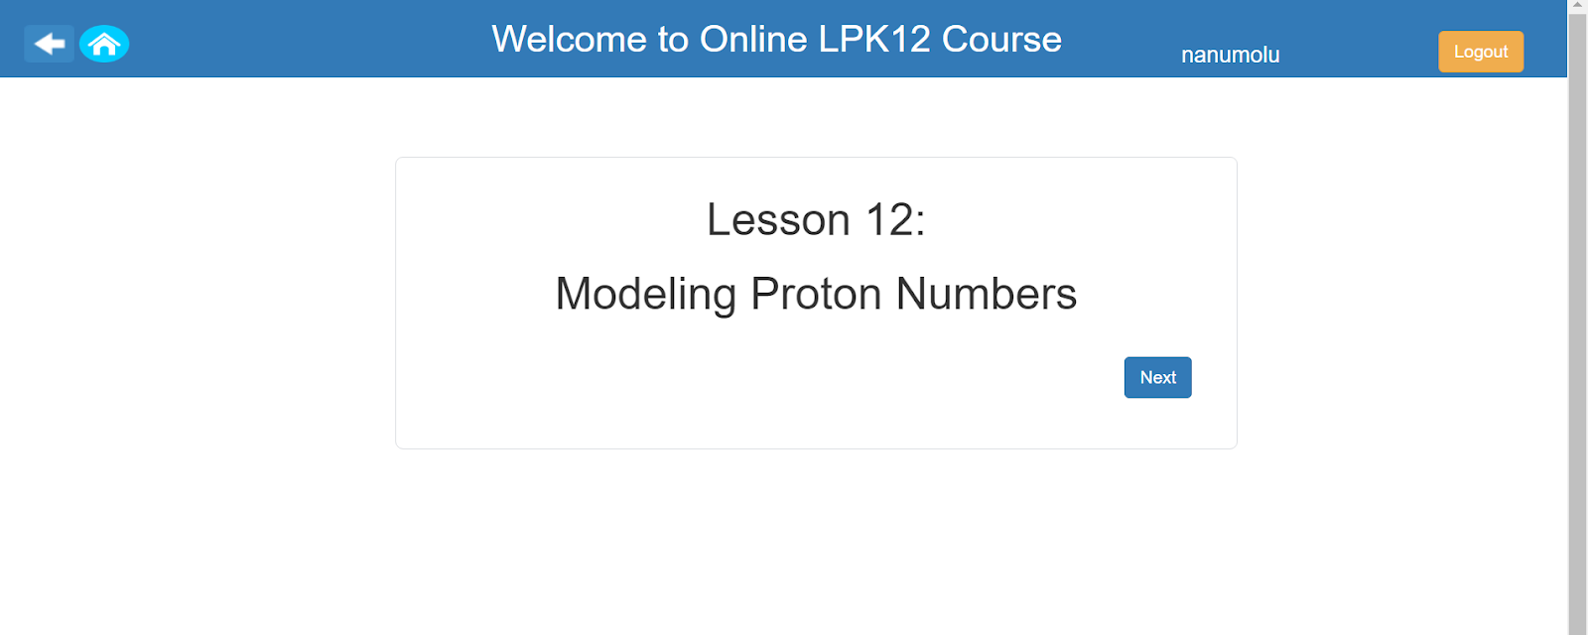
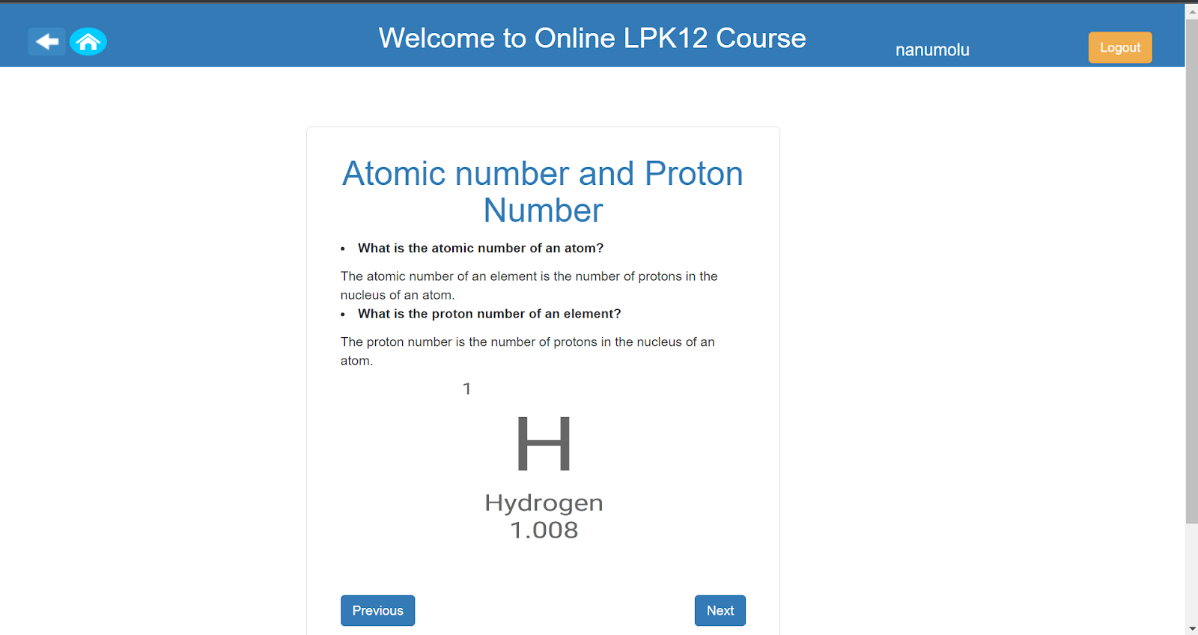
Populated the system with new lessons

Slide 17
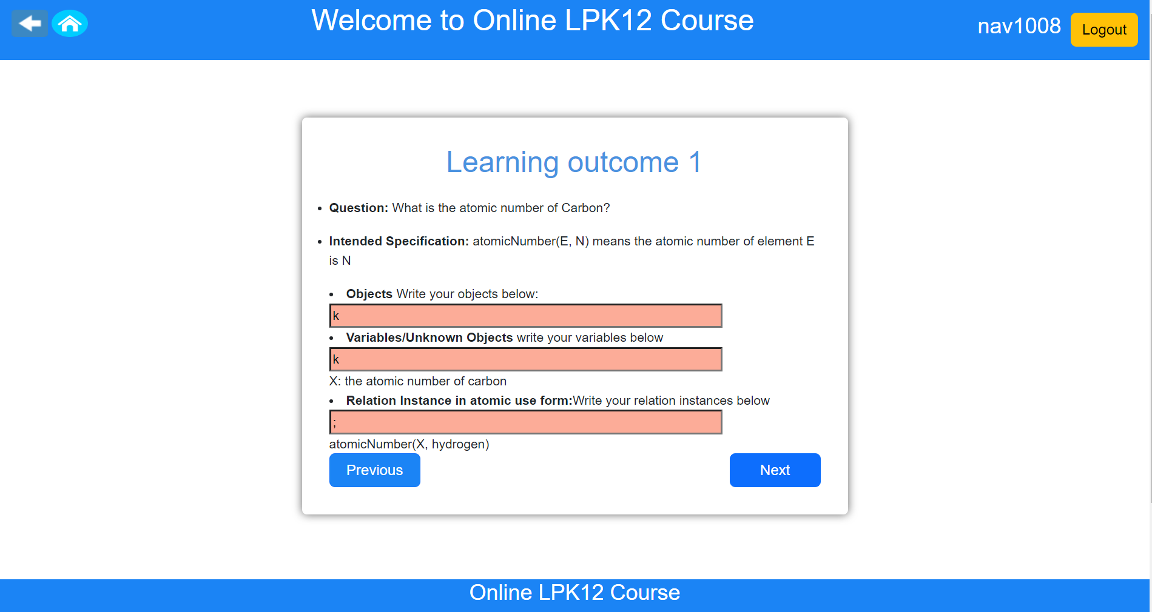
Added Assessments in New Lessons

Slide 18
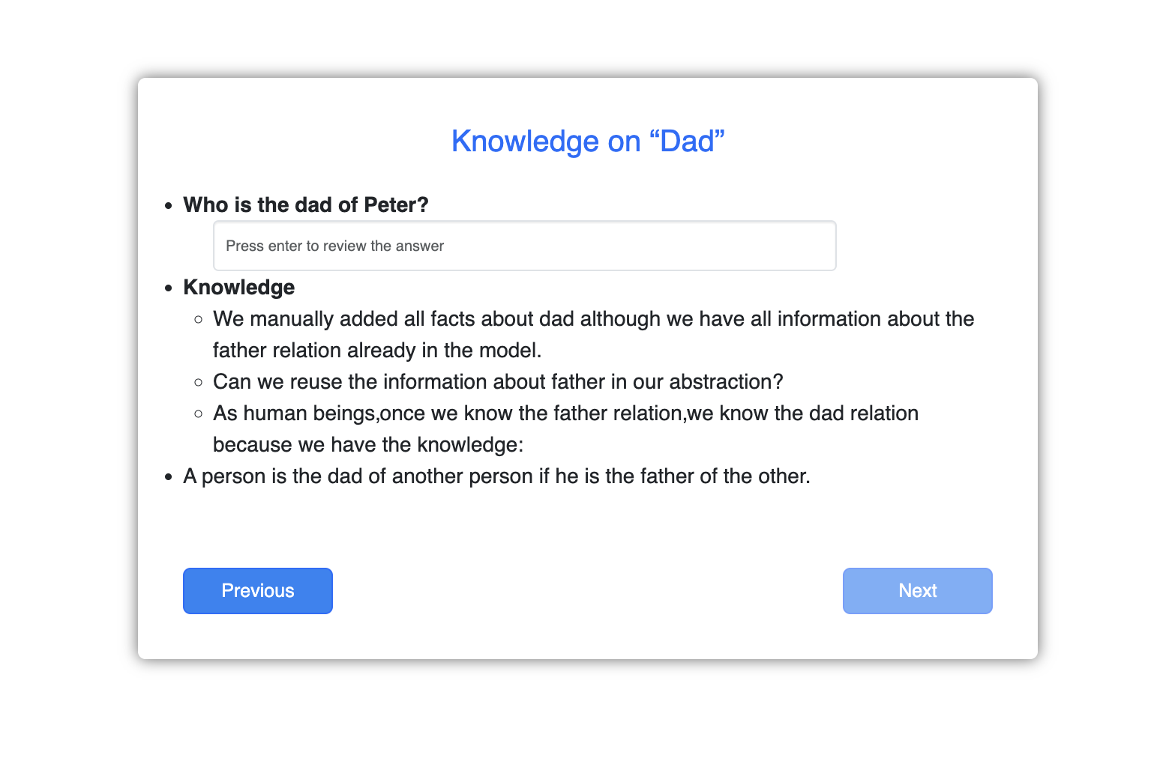
Introducing New Table: QuizQuestionAnswers
Student Answering question
Unique identification for each answers.
Specialized place in software where all the answers given by the user during quizzes are kept safe and organized.
Introduction to the quiz answers storage system.
Every time someone submits and answer to a quiz question, our system gives a special number that no other answer has. This is like giving every answer its own badge so we can tell them apart easily.

Slide 19
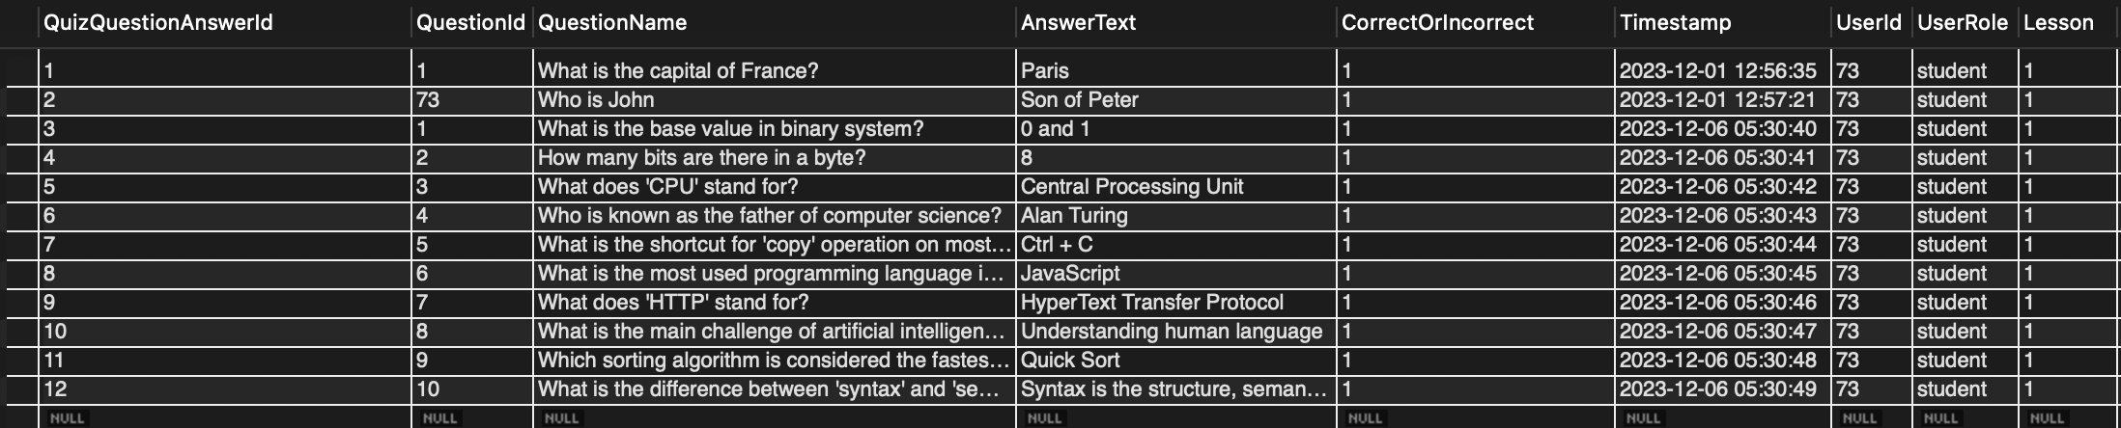
Sample Record Table
Automatically Generated QuestionAnswerId based on student submission of answers
Validation on whether answer is correct or incorrect will be done in UI based on student submission

Slide 20
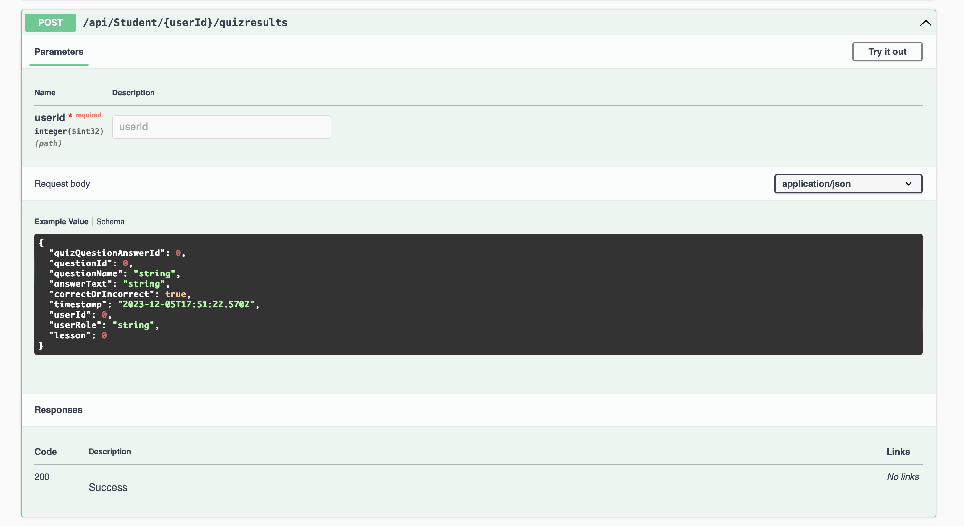
New API Endpoint for Quiz Submissions

